Slide 1
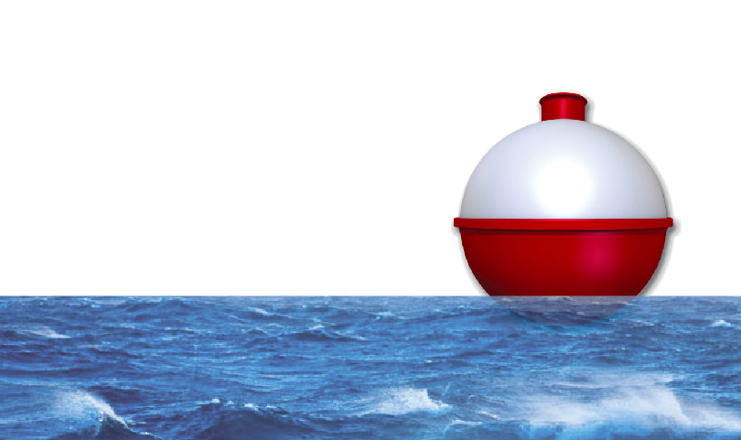
BOBino 1.6.1H Environmental Logger Kit
Taylor Brockman
2017-JUL-27

Slide 2

Why BOBINO?
Students need exposure to electronic data logging, statistical analysis and visualization.
Commercial alternative is $1500
Cha Ching!

Slide 3

What’s NEW?
Bermuda Buoys!
BOBino Shield Kit available now!
New Water Protection – Ziplock!
August 21 Eclipse Safety Briefing

Slide 4
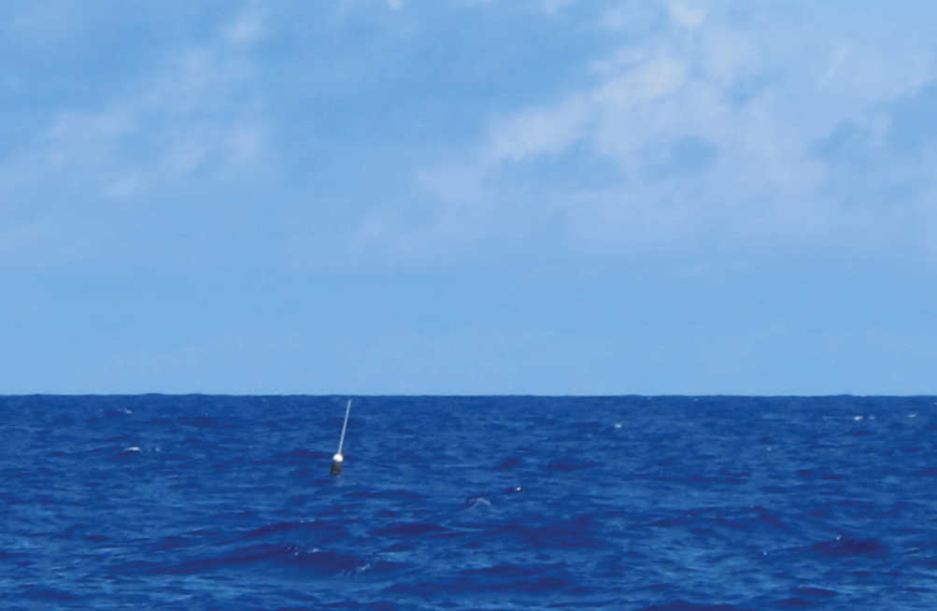
BERMUDA BUOY Sighting!

Slide 5
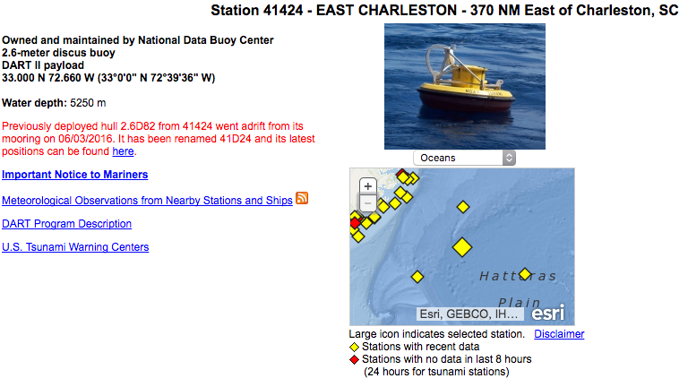
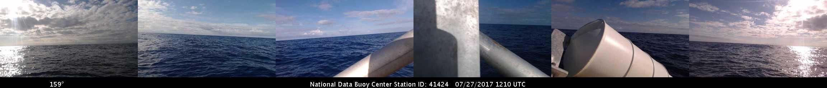
NOAA DART 41424

Slide 6
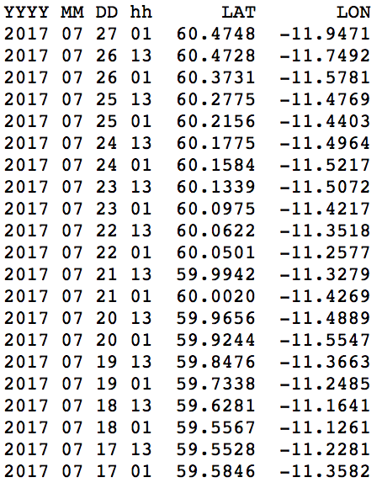
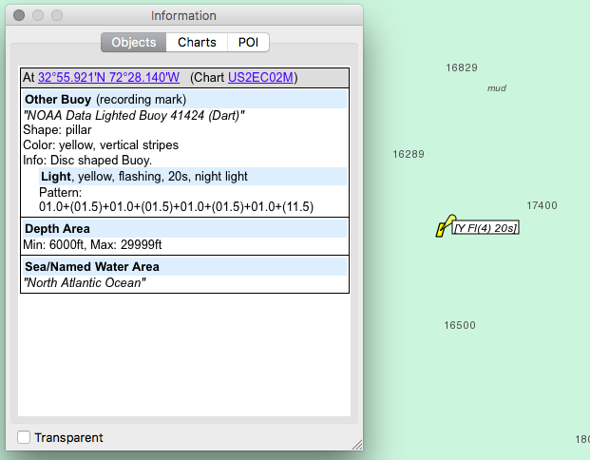
2.6D82 Adrift!
http://www.ndbc.noaa.gov/nws_special/41d24.txt

Slide 7
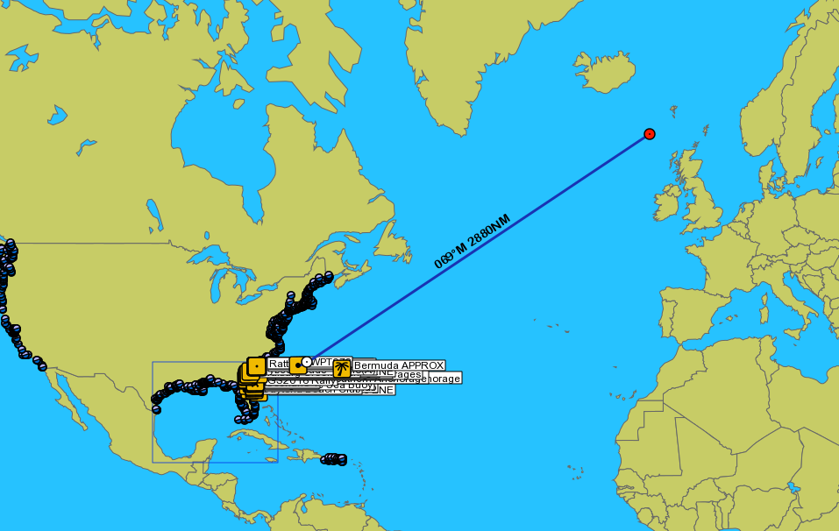
2.6D82 Adrift!
http://www.ndbc.noaa.gov/nws_special/41d24.txt

Slide 8
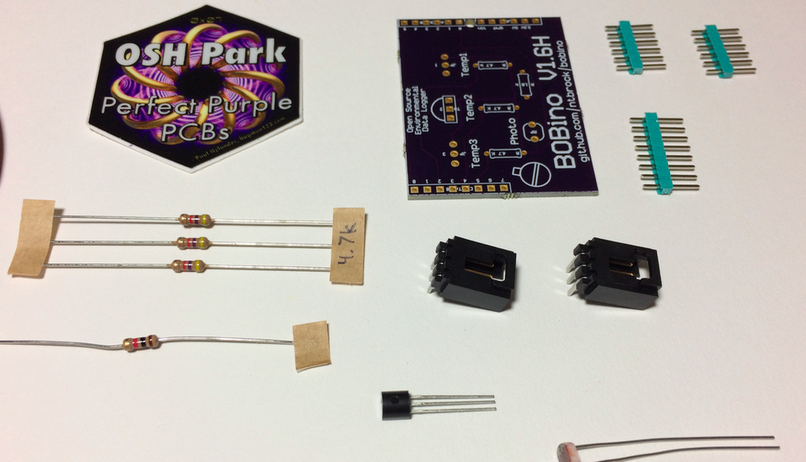
BOBINO Shield Kit: Just add Solder

Slide 9
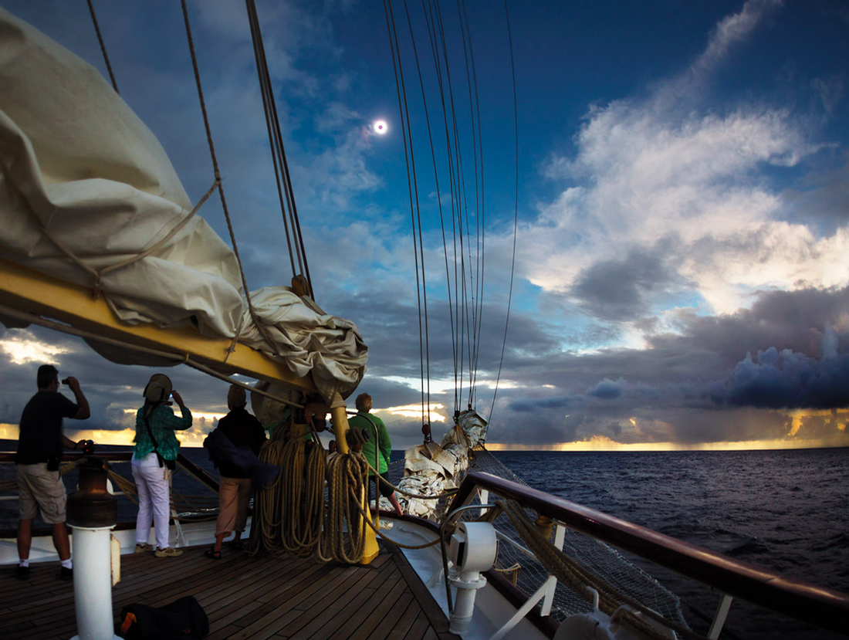
NOAA DART 41424

Slide 10
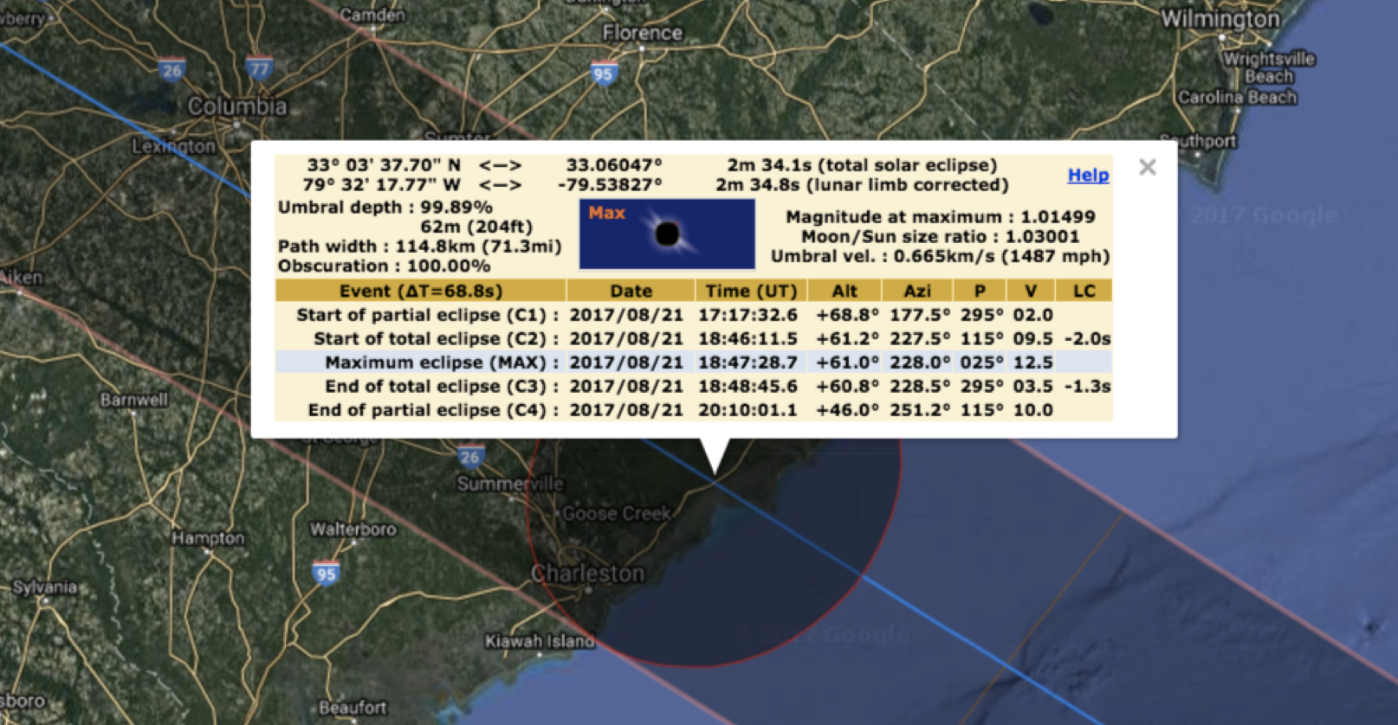
PATH OF TOTALITY

Slide 11

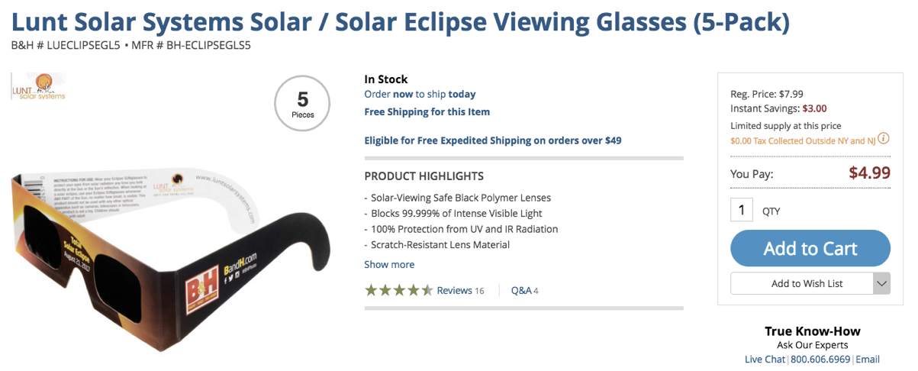
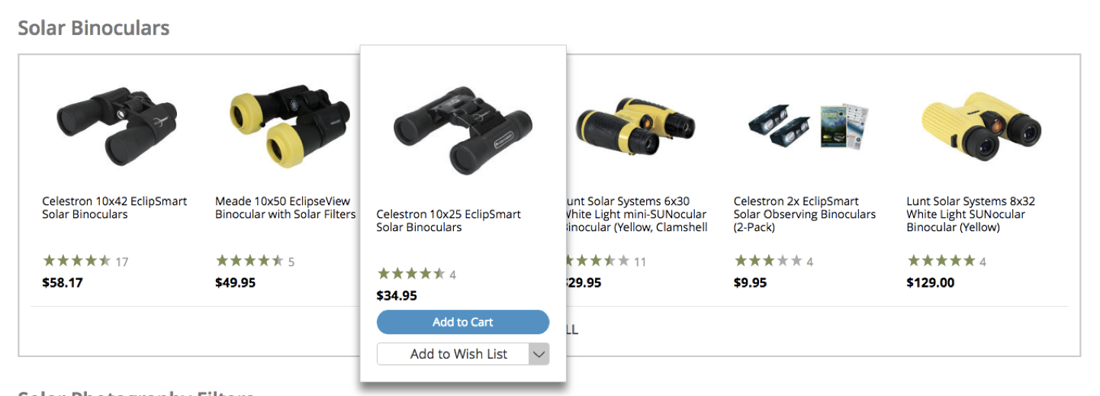
Safety First

Slide 12
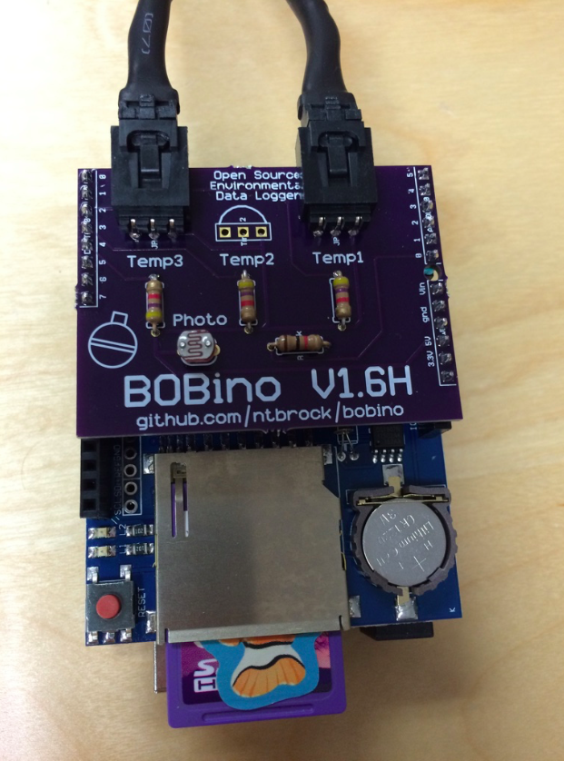

BOBino workshop

Slide 13
POP that ZIPLOCK OR tupperware open!
STICKERS! (w/ QR Code)
Arduino UNO plus “Shields”
SD Memory Card
2 Temperature Sensor Wires
Order Doesn’t Matter
USB Battery and 2 Cables
Power it up! Recharge anytime!

Slide 14

We are LOGGIN The DATA!
Default interval is 15 seconds
Try covering up the Photo Sensor
Try warming up a Temp Sensor
Temp Sensors are submersible
(Bubble Bubble Bubble)

Slide 15

Let’s take a look ON OUR LAPTOPS
SD Card can be plugged into any laptop or PC.
DATA.CSV is “Comma Separated Values” that opens well in Excel.
Change the Log Rate in CONFIG

Slide 16
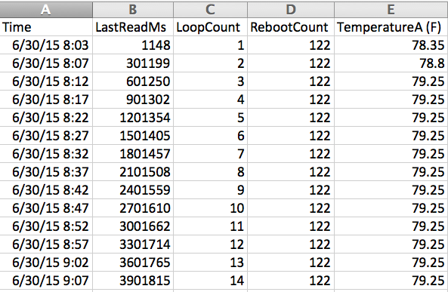
Let’s take a look ON OUR LAPTOPS

Slide 17
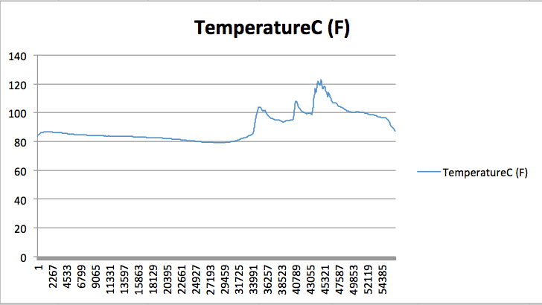
Let’s take a look ON OUR LAPTOPS

Slide 18
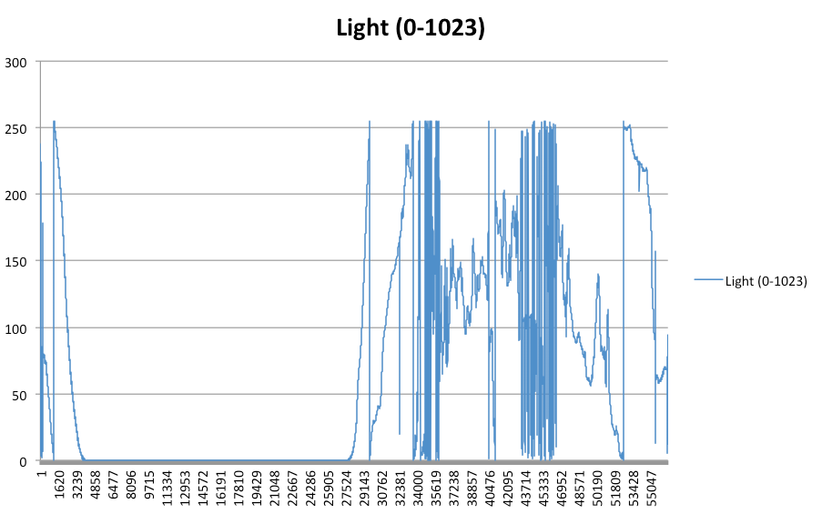
Let’s take a look ON OUR LAPTOPS

Slide 19
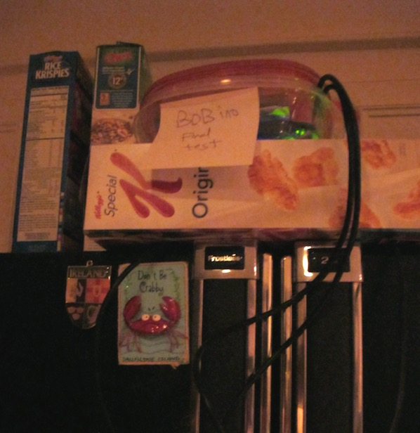
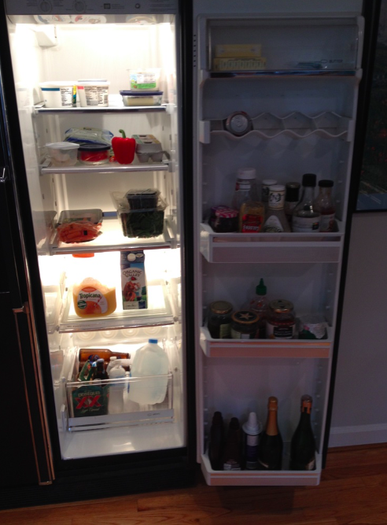
Maybe it’s time to get a new fridge?

Slide 20
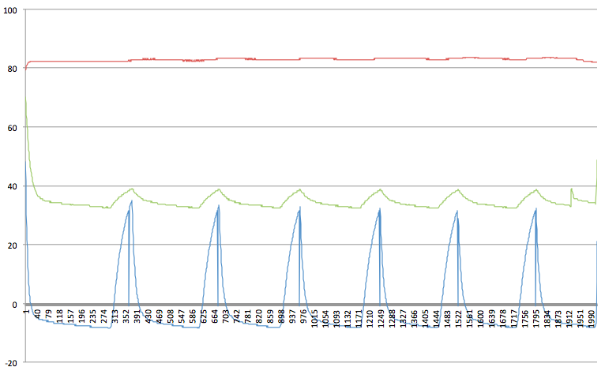
Maybe it’s time to get a new fridge?
Morning Juice!

Slide 21
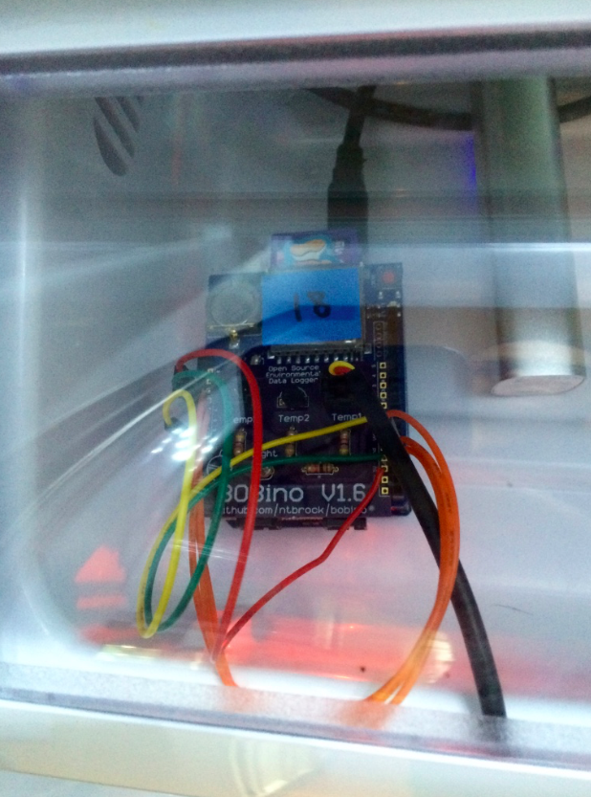
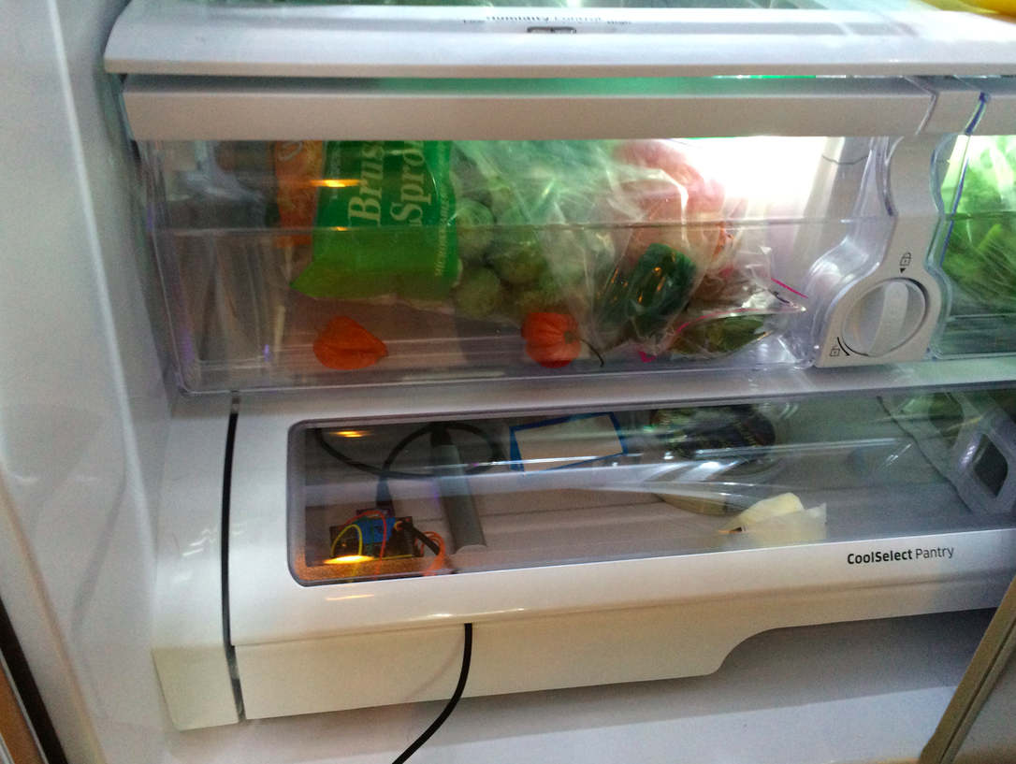
WE GOT A NEW FRIDGE! Let’s Log SOME DATA!

Slide 22
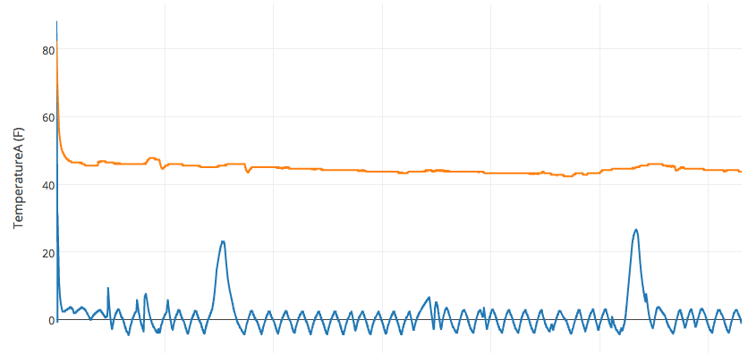
Maybe it’s time to get a new fridge?
Refrigeration cooling is constant.
Much faster shorter compressor cycle.
Quick temperature loss when lower freezer drawer is opened.

Slide 23
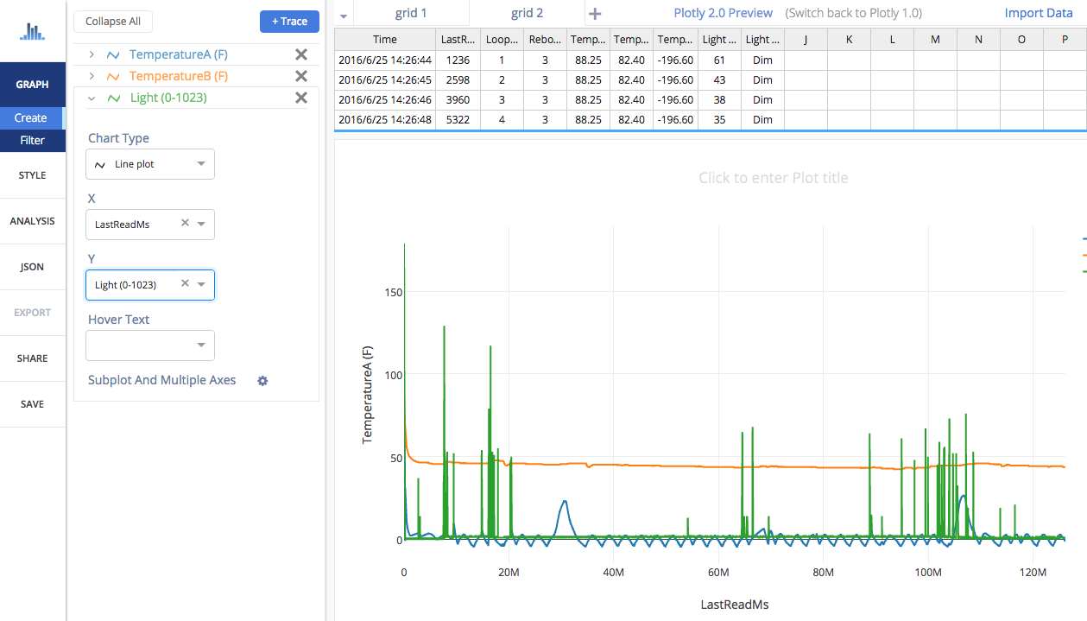
INTRODUCING: PLOTLY

Slide 24
Experiment IDEAS
Refrigerator Performance
Water Heating via Solar Radiance
Air –vs– Water Temperature Diff
Solar Day Length
Cloud Cover –vs– Temperature
Air Conditioner Thermostat Accuracy
Solar Eclipse Monitoring!

Slide 25

For the Experts
All Source Code is available!
Use the Arduino Programmer, Free Download!
Add More Hardware, Change Shields, Increase the Battery Size
Ocean or Sky is the limit!

Slide 26

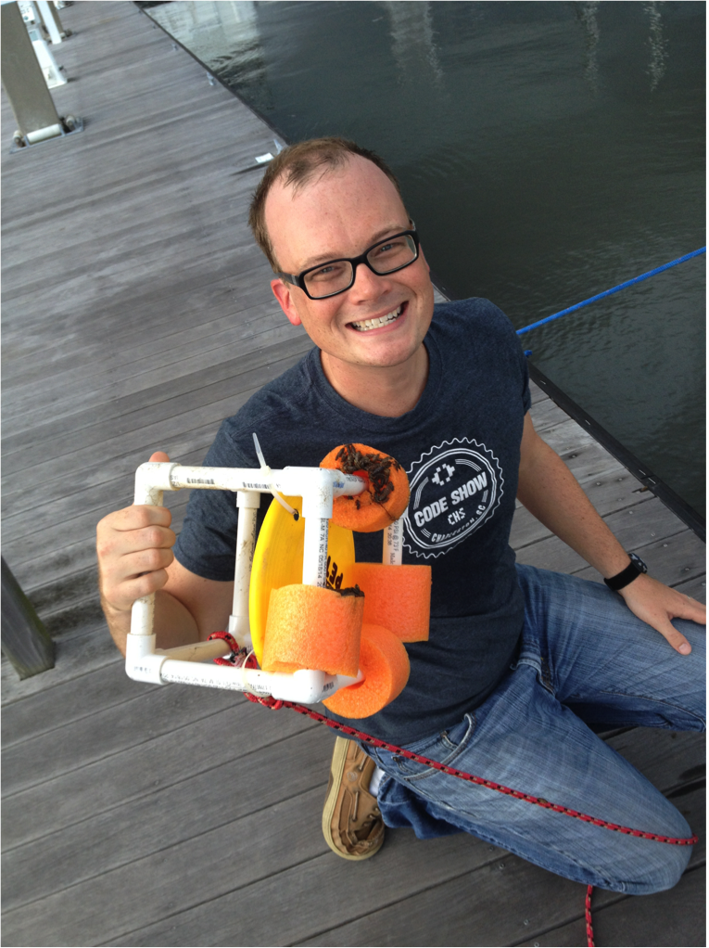
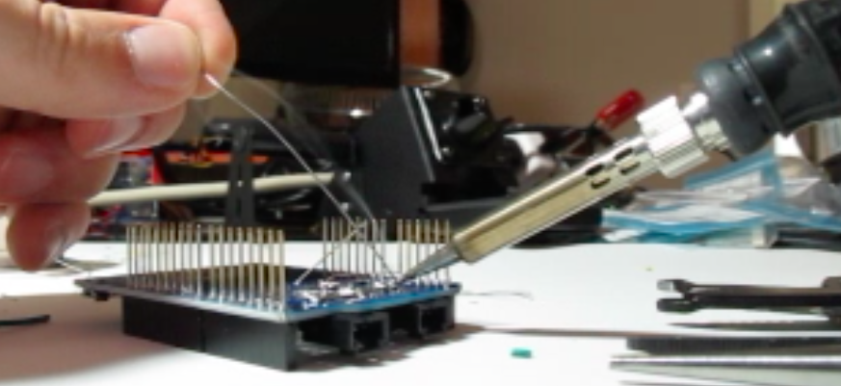
Story Time & Fun pictureS
Marina

Slide 27
BOBino 1.6.1H Environmental Logger Kit
Taylor Brockman
2017-JUL-27

